Slide 1
Greetings and Intros
Basic 1 Lesson A

Slide 2
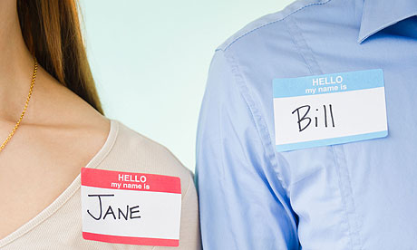
What is her name?
Her name is Jane.
What is his name?
His name is Bill.

